Slide 1

Customer Insights: Top Countries, Cities and Key Customers
George Kechichian
2025/02/04

Slide 2
Business Context & Objectives
Context: We aim to understand where our customers are located and identify regions, cities, and individuals that significantly contribute to our business.
Why This Matters:
Helps target marketing campaigns and operational efforts more effectively.
Supports building strong relationships with key customers.
Provides insights for expanding in underperforming regions.
Key Areas of Focus:
Top countries by customer count and revenue
Key cities driving business within those countries
Customers contributing the most revenue
Objectives:
Highlight trends in customer distribution
Identify opportunities for growth
Inform strategic decision-making

Slide 3
Initial Data & Approach
Data Overview:
Film Table has 1,000 entries
All movies were released in 2006
Rental Duration: 3 days minimum, 7 days maximum, 5 days on average
Rental Rates: Range from $0.99 to $4.99 with an average of $2.98
Most common rating is PG-13
Why does this matter?
Provides insight into customer preferences and rental behaviors
Helps analyze trends in customer geography
Analytical Approach:
Identifying top-performing countries and cities

Slide 4
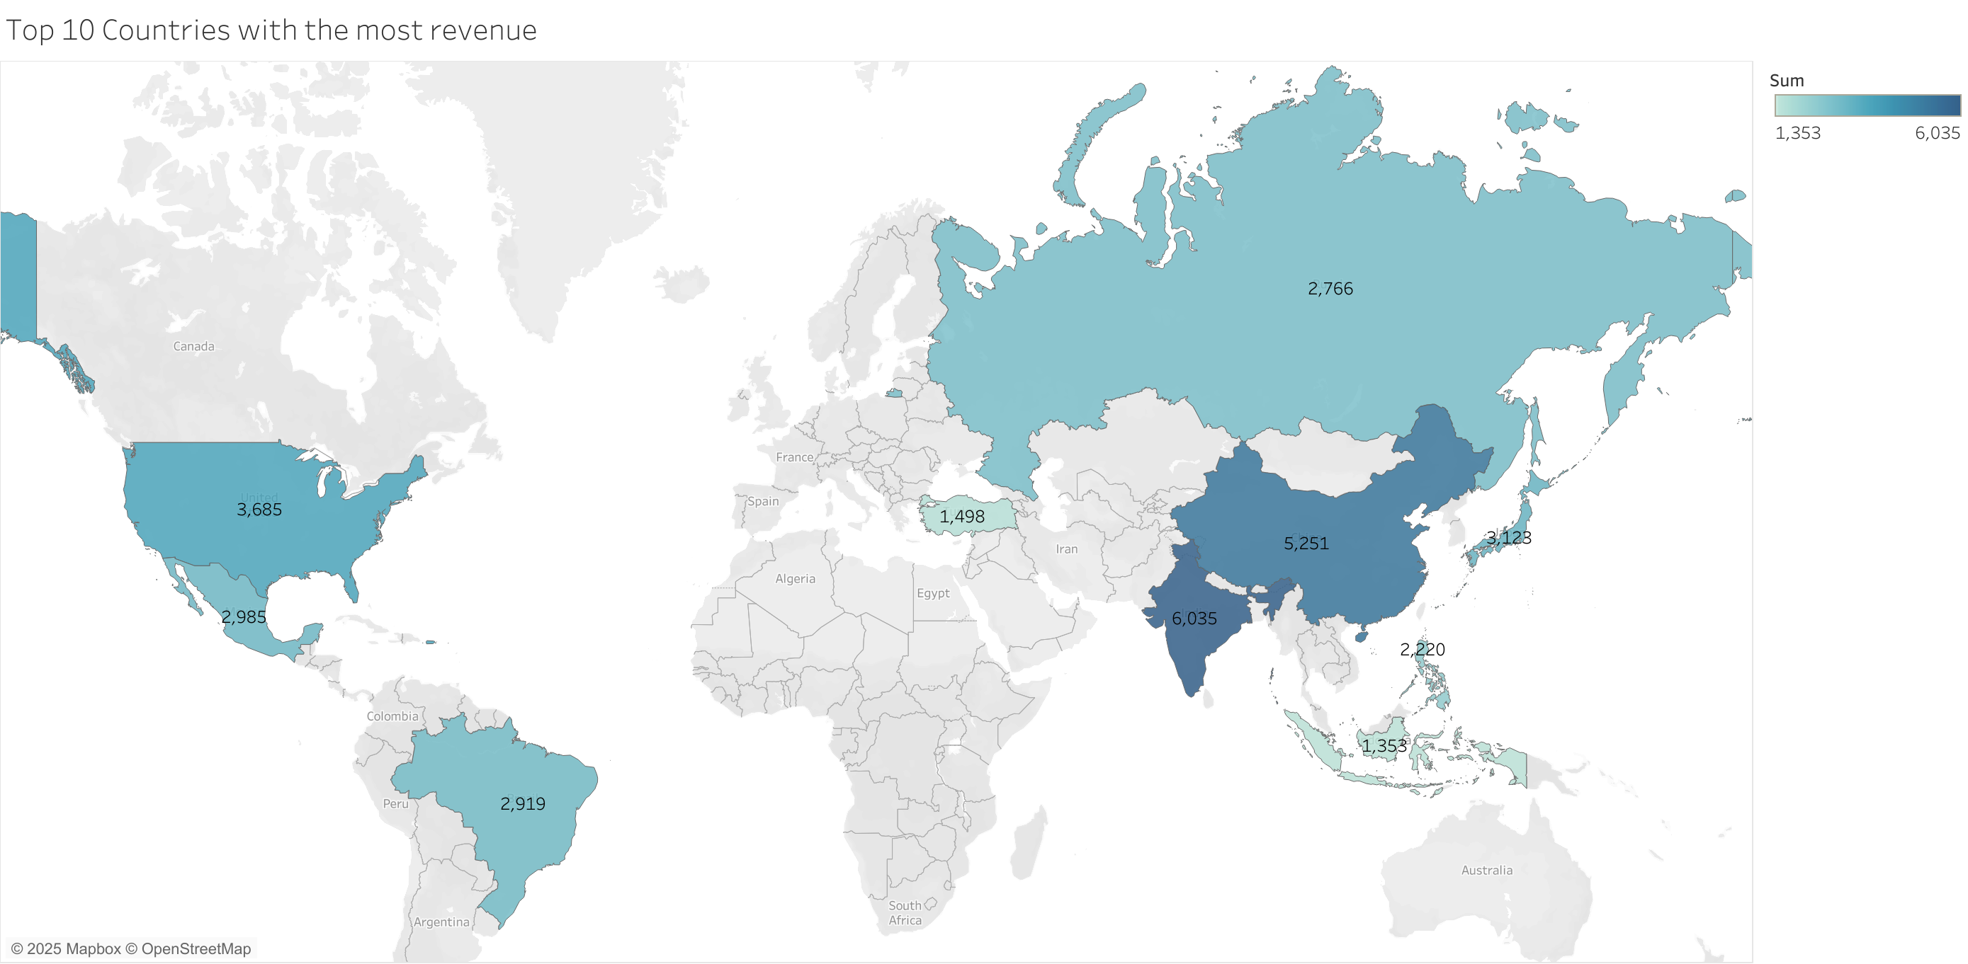
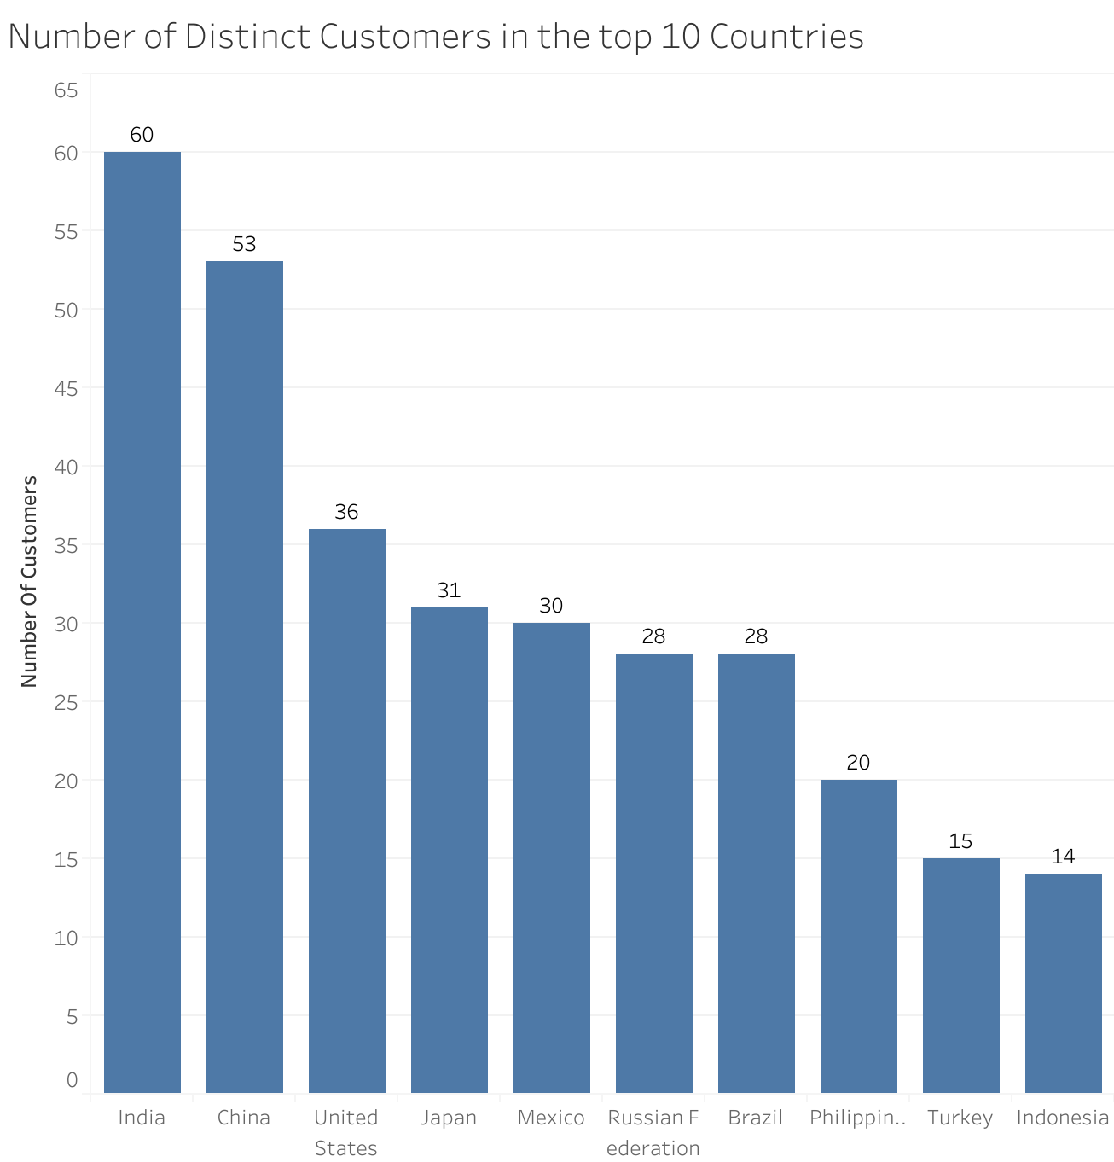
Top 10 Countries by Customers & Revenue
Key findings:
India, China and the United states had the most revenue and the largest number of distinct customers
Key Insights:
The top 10 countries contributed to 52% of total revenue.

Slide 5
Top 10 Cities with the Most Customers
City | Country | Number of Customers | Revenue
Cape Coral | United States | 1 | 208.58
Santa Brbara dOeste | Brazil | 1 | 194.61
Memphis | United States | 1 | 167.67
Tanza | Philippines | 1 | 166.61
Valparai | India | 1 | 162.67
Santa Rosa | Philippines | 1 | 161.68
Aurora | United States | 2 | 159.58
Tanauan | Philippines | 1 | 156.66
Halisahar | India | 1 | 154.70
Bijapur | India | 1 | 154.66
The United States, Philippines, and India account for 9 of the top 10 cities.
The top city is in the US followed by a city in Brazil.

Slide 6
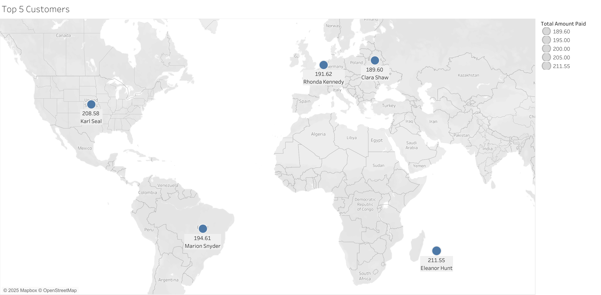
Top 5 Customers by Revenue Contribution
Three of the top 5 do not live in the top 10 countries.
Eleanor Hunt from Saint-Dennis Runion, spent the most renting videos (211.55).

Slide 7
Conclusion & Recommendations
Summary:
India, China, and the United States are critical revenue-driving regions.
Our customer base isn’t limited to specific countries, as evidenced by the diverse locations of our top 5 customers.
Recommendations:
Target marketing in dominant cities/countries.
Strengthen relationships with high-value customers

Slide 8
Next Steps & Questions
Next Steps:
Deeper analysis on market trends.
Detailed analysis on rentals and customer preferences/behaviors.
Open to any questions or feedback.

